Slide 1
Metamodel
Global view

Slide 2
Some sources
Object Modeling with UML: Advanced Modeling, Karin Palmkvist, Bran Selic, and Jos Warmer, March 2000

Slide 3
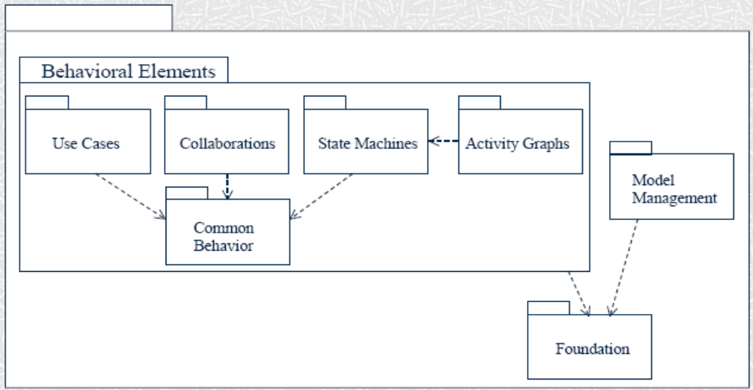
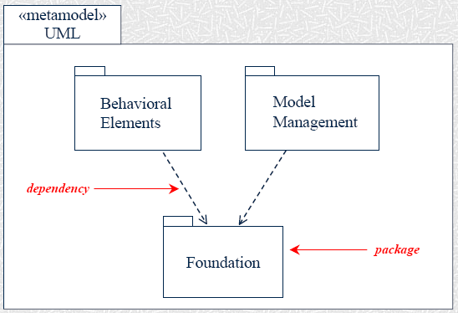
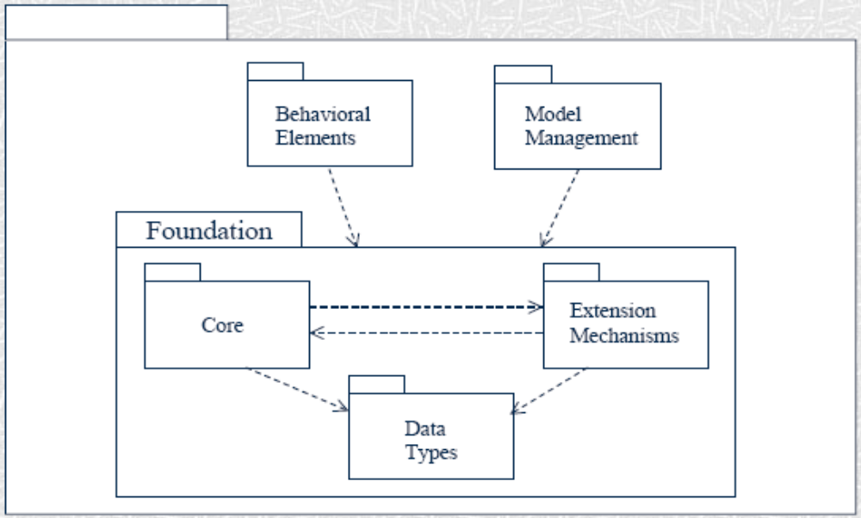

Slide 4
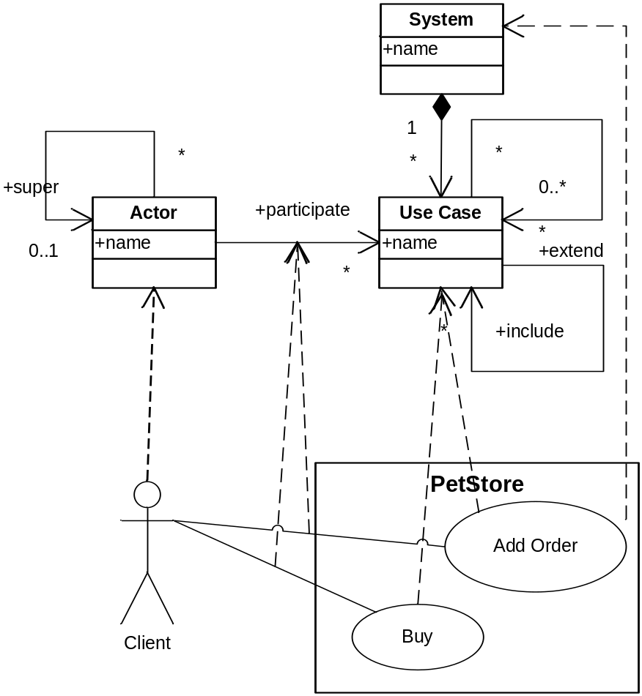
Meta-model
Capitalization
A meta-model defines concepts and their relationships thanks to a class diagram.
A meta-model only defines structure (no semantic).
A model is an instance of a meta-model if it respects the structure defined by the meta-model.
The UML meta-model defines the structure that all UML models must have.

Slide 5
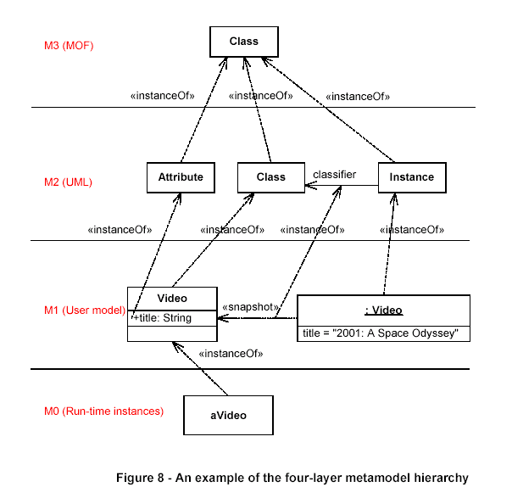
An Example:
UML metamodel in the 4 Layer

Slide 6
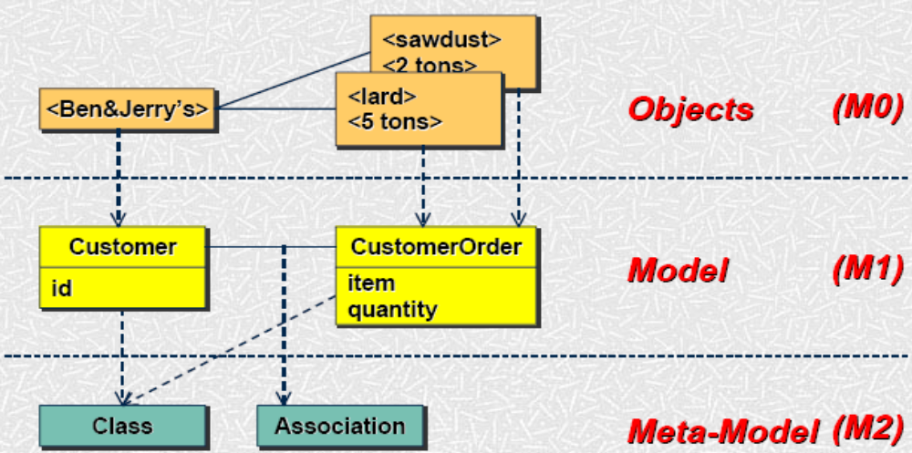
Another Example:
UML metamodel in the 4 Layer

Slide 7
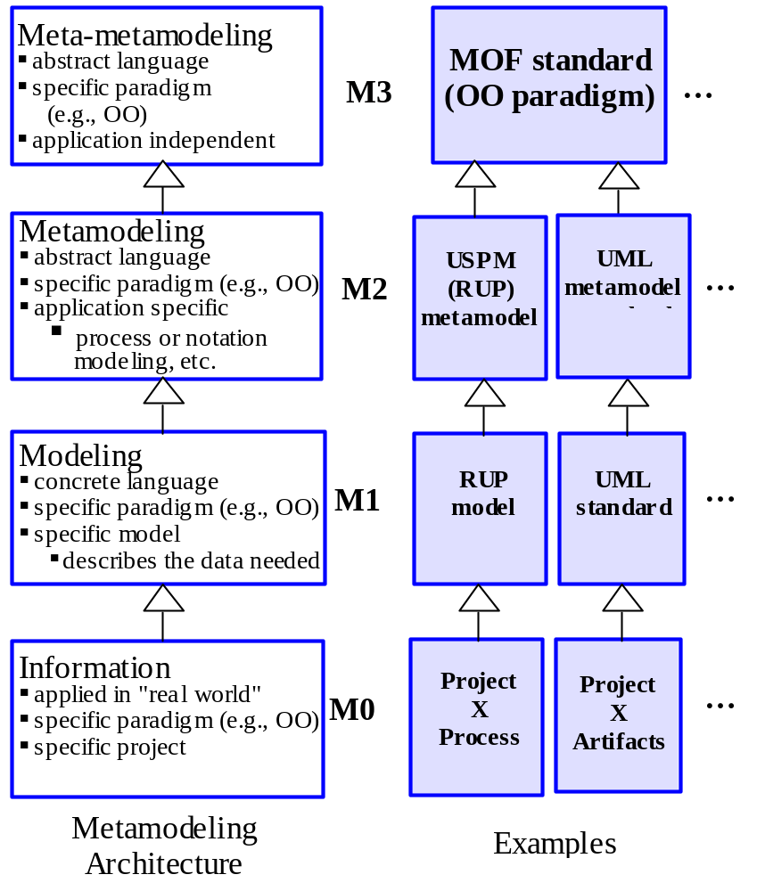
Points to Ponder
Can we create a new version of UML, in consideration of the following?
MetaClass, MetaAttribute, MetaOperation
Class, Attribute, Operation, Component
StockShare, owner, askPrice
hacsSoftwareCoShare99, smartie, 11.18

Slide 8
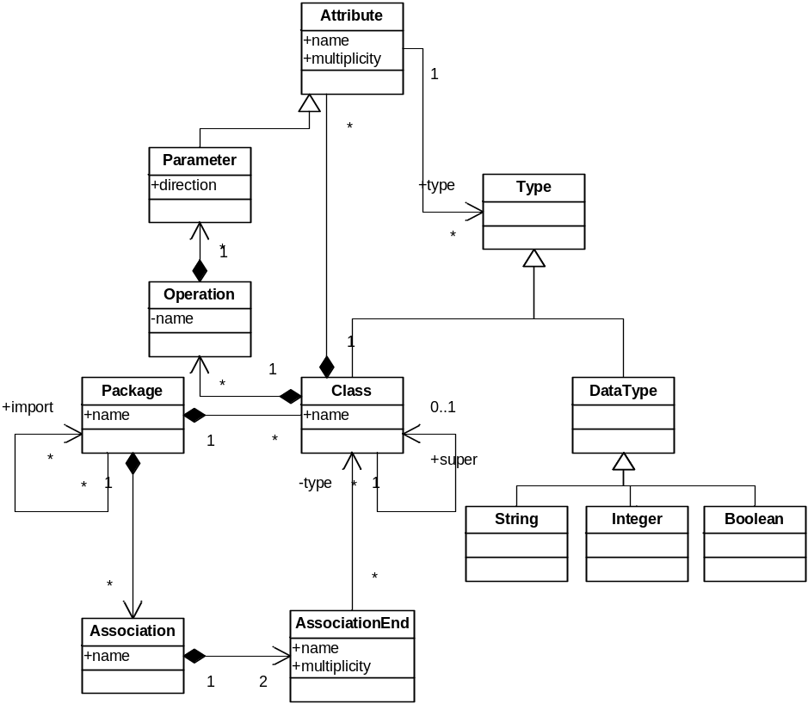
Meta-meta-model
MOF defines the language for defining meta-models
MOF concepts are meta-class, meta-attribute, meta-association, etc.
MOF concepts and their relationships can be defined by a class diagram. This diagram is also a meta-model (called the meta-meta-model)
The meta-meta-model is self defined.

Slide 9
Meta-layers
Capitalization
Mn+1 defines the structure of Mn
Mn+1 is not an abstraction of Mn
Meta-layer relationships are similar to grammar-layer relationships (BNF, or XML Schema)
MOF
Meta-meta-model
UML
UML
UML
Meta-model
Modèle
Modèle
Modèle
Model

Slide 10
Infrastructure: Consolidation of Concepts
Namespace
PackagableElement
RedefinableElement
Classifier
Feature

Slide 11
Infrastructure: Behavior Harmonization
Common semantic base for all behaviors
  Choice of behavioral formalism driven by application needs
0..1
0..*
Classifier
Behavior
Class
UseCase
Component
. . .
Action
Activity
Interaction
Statemachine

Slide 12
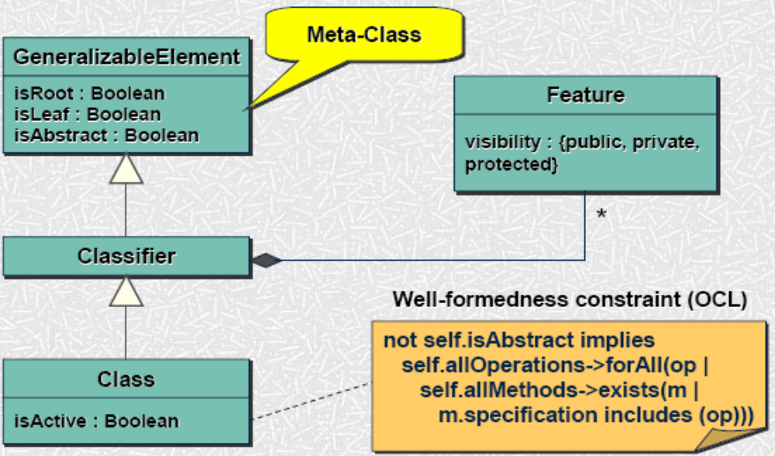
Classifier & Class

Slide 13
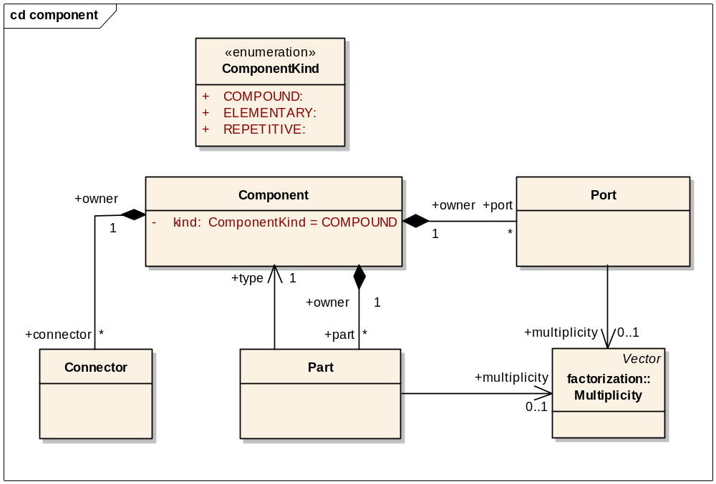
Common component paradigm
Encapsulation
Repetition of structural elements
Assembling
Composing

Slide 14
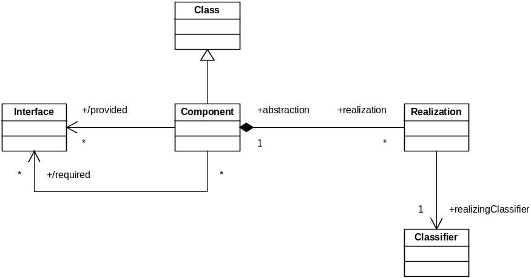
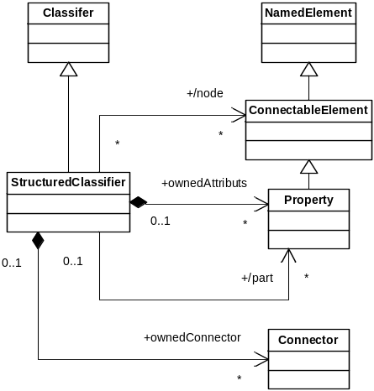
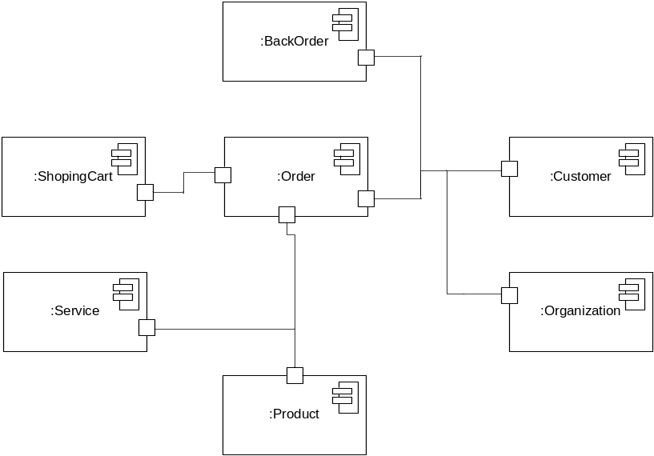
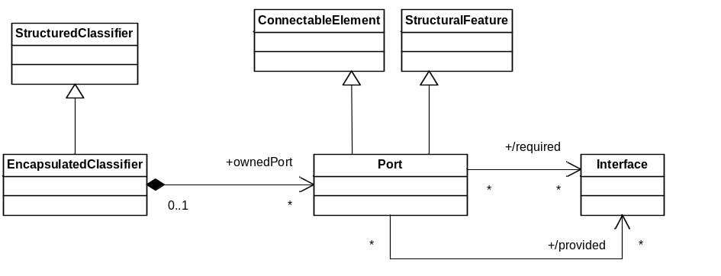
UML2.0 Component

Slide 15
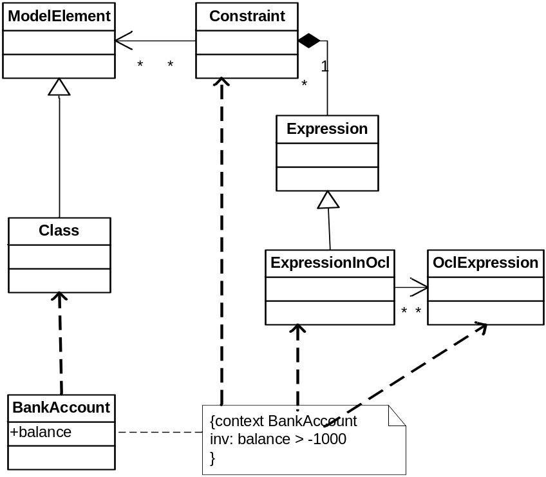
Object Constraint Language
Capitalization
OCL defines the structure of models expressing constraints
  Invariant, Pre-post conditions
OCL is a meta-model instance of the MOF
OCL is highly coupled with UML
The OCL semantic is defined with models (operation without side effect )
OCL defined a concrete syntax
PropertyCallExp
>
ModelPropertyCall
amount
Literal
-1000

Slide 16
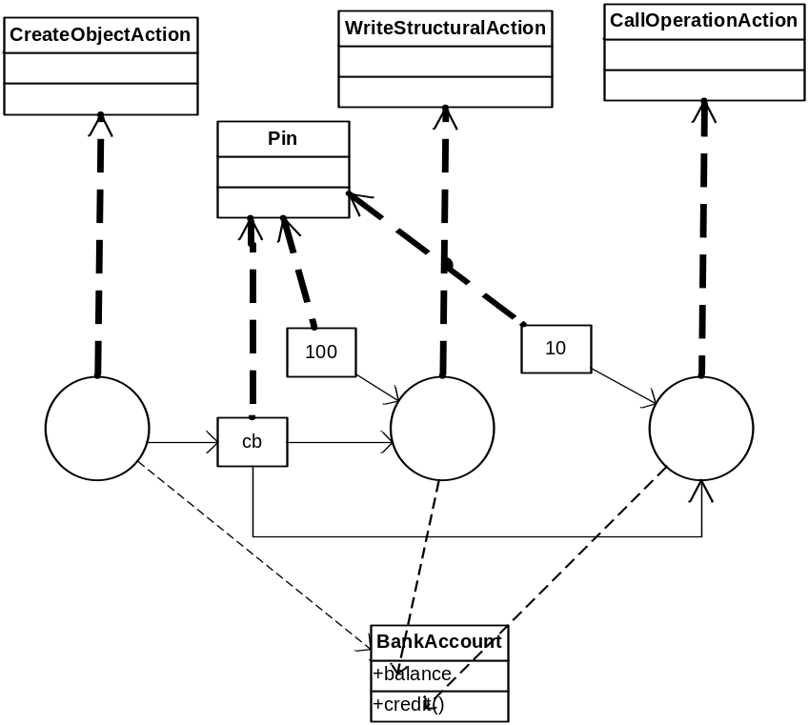
Action Semantics
Capitalization
AS defines the structure of models expressing sequences of actions
AS was a meta-model and is now completely integrated in UML2.0
AS has no concrete syntax (UML diagram)
The semantic of AS is not formally defined (an RFP is published)

Slide 17
Template
Productivity
Model transformation is a template written in a dedicated language
UML
EJB
UML2EJBTemplate
PetStore
Template
Interpretor
PetStore
EJB

Slide 18
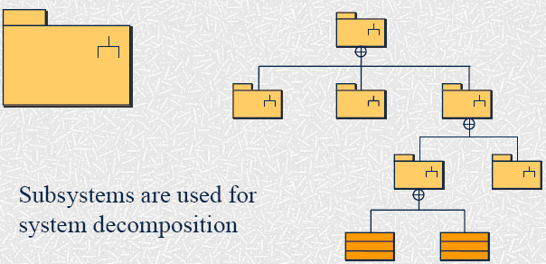
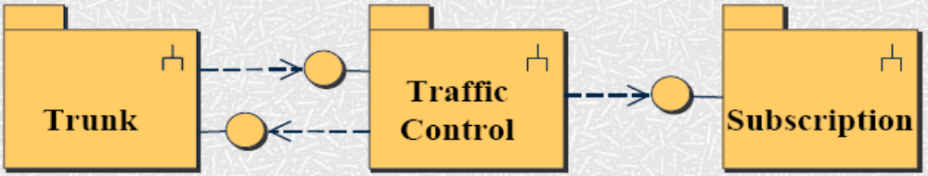
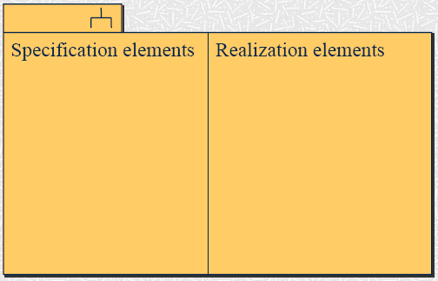
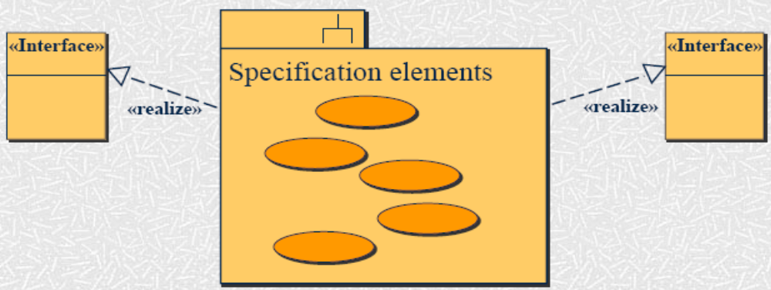

Slide 19
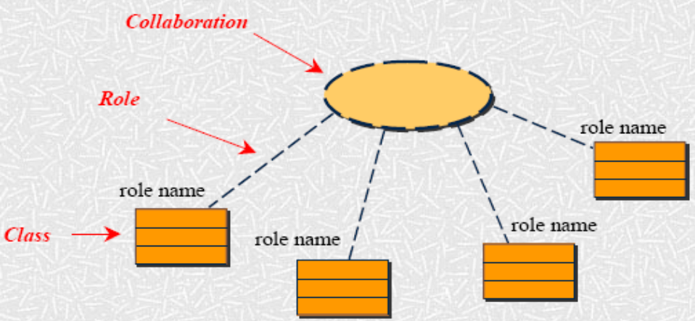
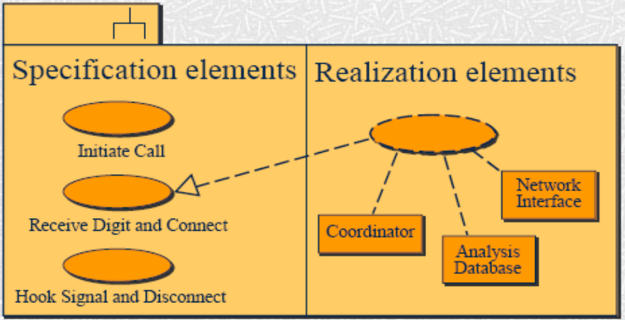
Collaboration

Slide 20
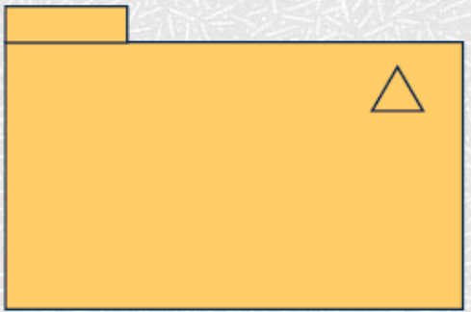
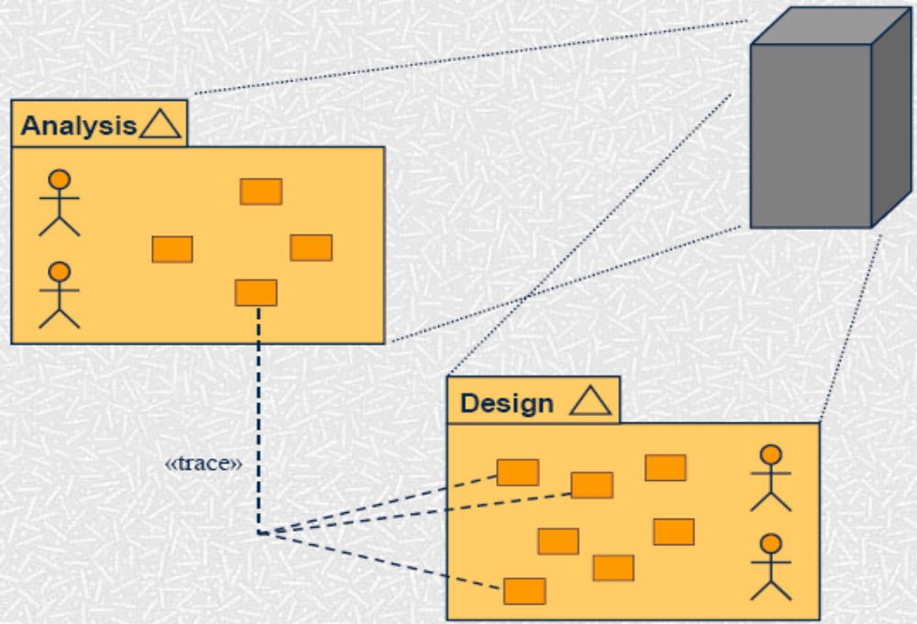
Models & Traceability
A model is an abstraction of a system, specifying the system from a certain viewpoint and at a certain level of abstraction

Slide 21
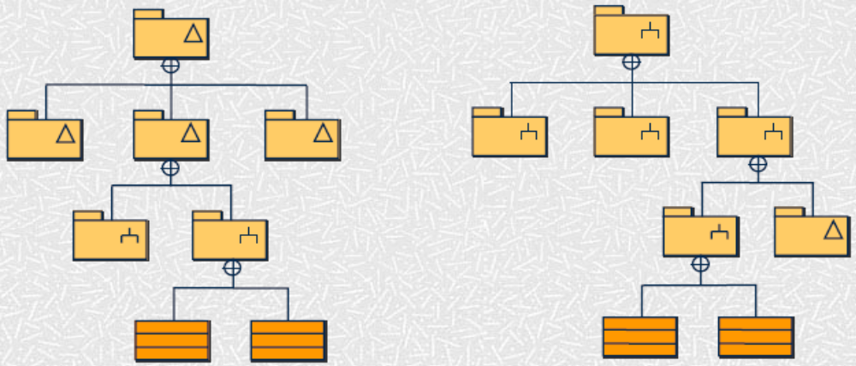
Model & System Hierarchy
Models and subsystems can be combined in a hierarchy:

Slide 22
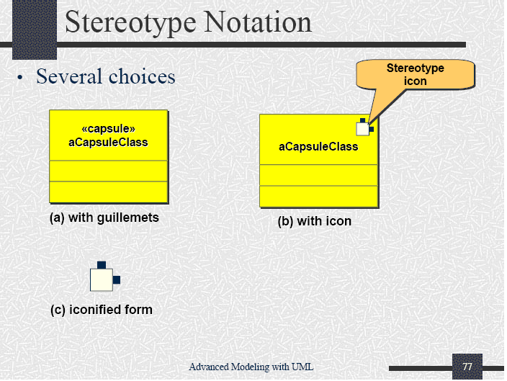
Stereotype Notation

